Slide 1




MOTION CUE
WHERE VISION MEETS REALITY
MENTOR:
DR. AMIT BHATI
TEAM MEMBERS NAME:
DEVESH SINGH NEGI( TEAM LEADER)
AMAN KUMAR
ANIKET KUMAR
PIYUSH DUBEY

Slide 2
OUTLINE-
Problem
Statement
PROPOSED SOLUTION
Abstract
revenue
model
Future Scope

Slide 3
ABSTRACT-
Revolutionize user interaction with Gesture-based navigation system.
Using Computer Vision Tech with Machine Learning Algorithm.
Simplify Digital Content Navigation.
Reduces reliance on traditional input devices.
Automates Manual Processes.

Slide 4
Problem Statement
MANUAL
PROCESS
PHYSICAL
INTERACTION
COST
OF
ADDITIONAL
DEVICES
SAFETY
COMPLIANCE
LIMITED
ACCESSIBILITY

Slide 5
Proposed Solution
EMPOWERING
ACCESSIBILITY
HANDS FREE INTERACTION
AUTOMATE
MANUAL
PROCESSES
ENSURING
SAFETY
REDUCE
COST

Slide 6
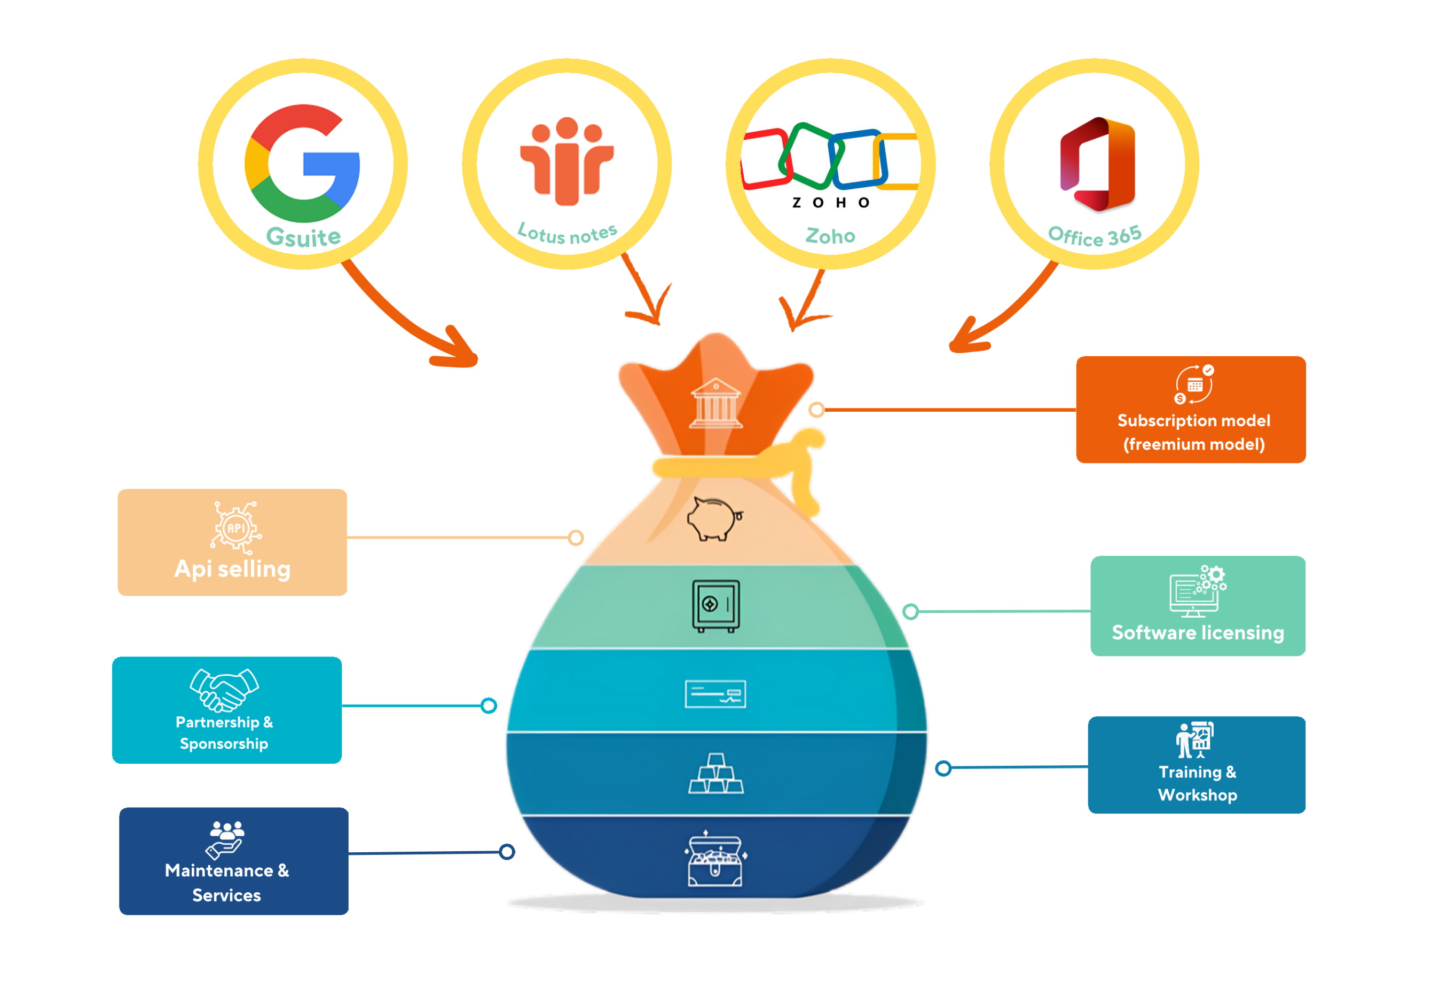
Revenue
Model

Slide 7
Future Scope
Riots detection
Gaming & Entertainment
Integration with ar & vr
Animal threat detection
Posture detection
Sign language recognition

Slide 8
THANK YOU

